Slide 1
Data Visualization
Unit III

Slide 2
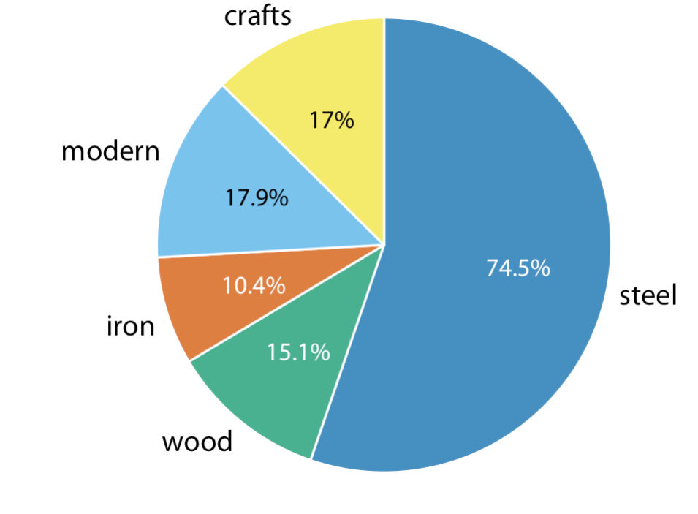
Visualizing Nested Proportions
When the data is in Nested form.
Political Parties, sub proportions

Slide 3
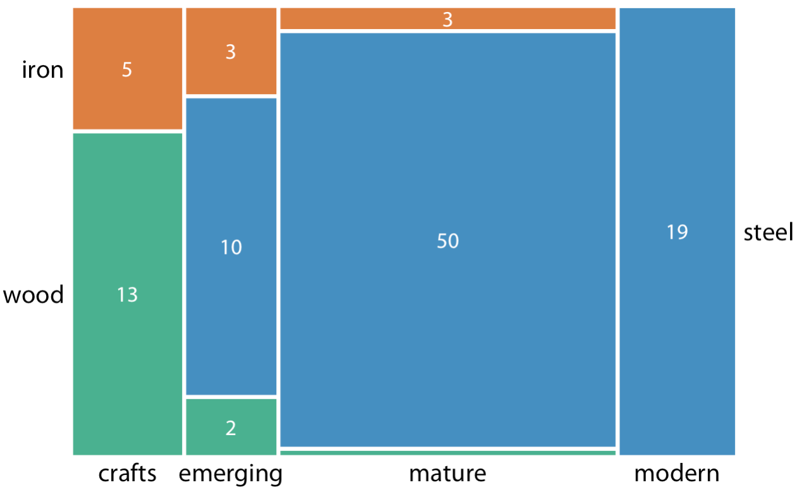
Mosaic Plots and Treemaps
Construction material (steel, wood, iron).
By era of construction (crafts, emerging, mature, modern)

Slide 4
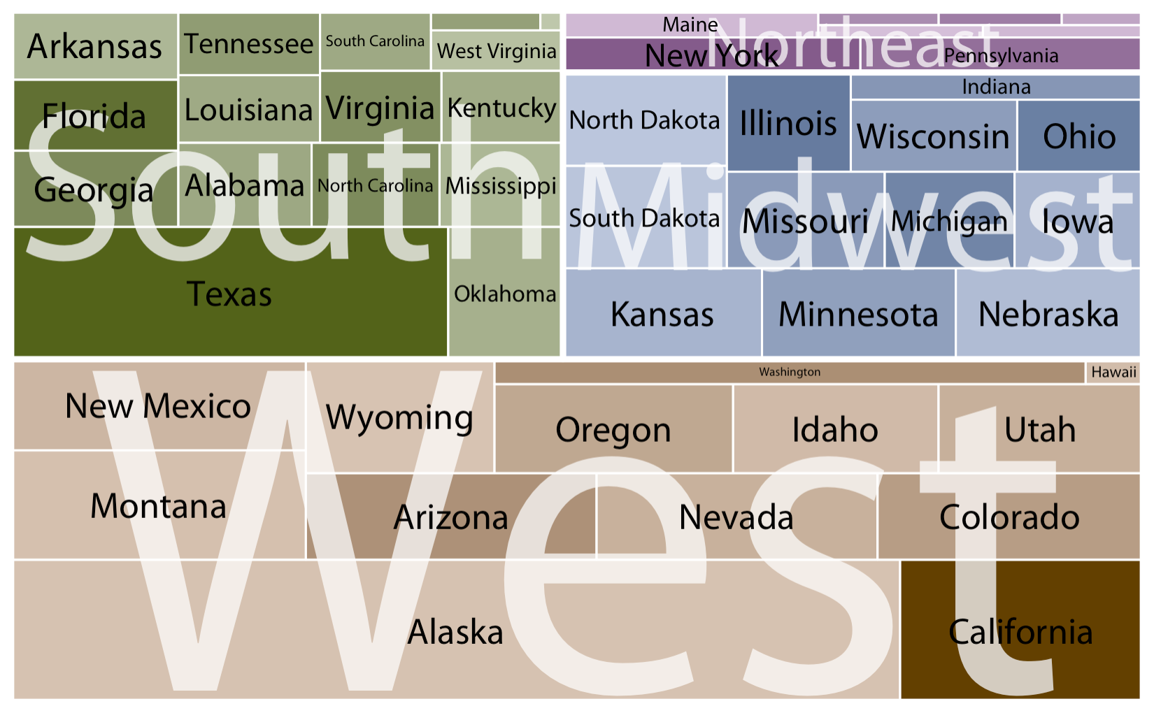
Mosaic Plots and Treemaps

Slide 5
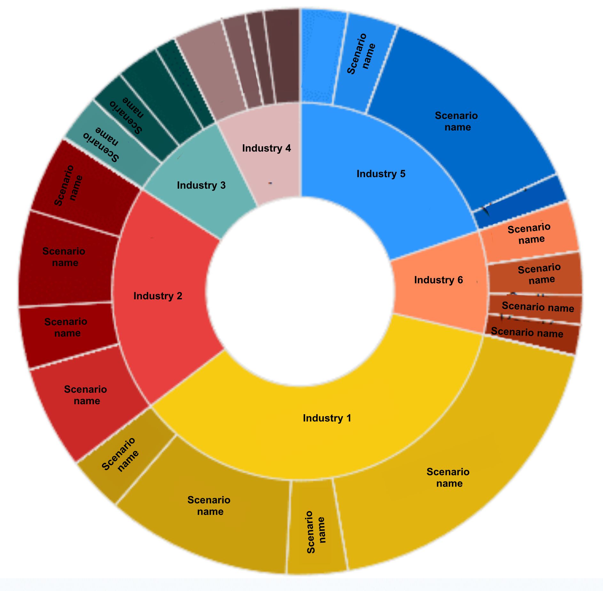
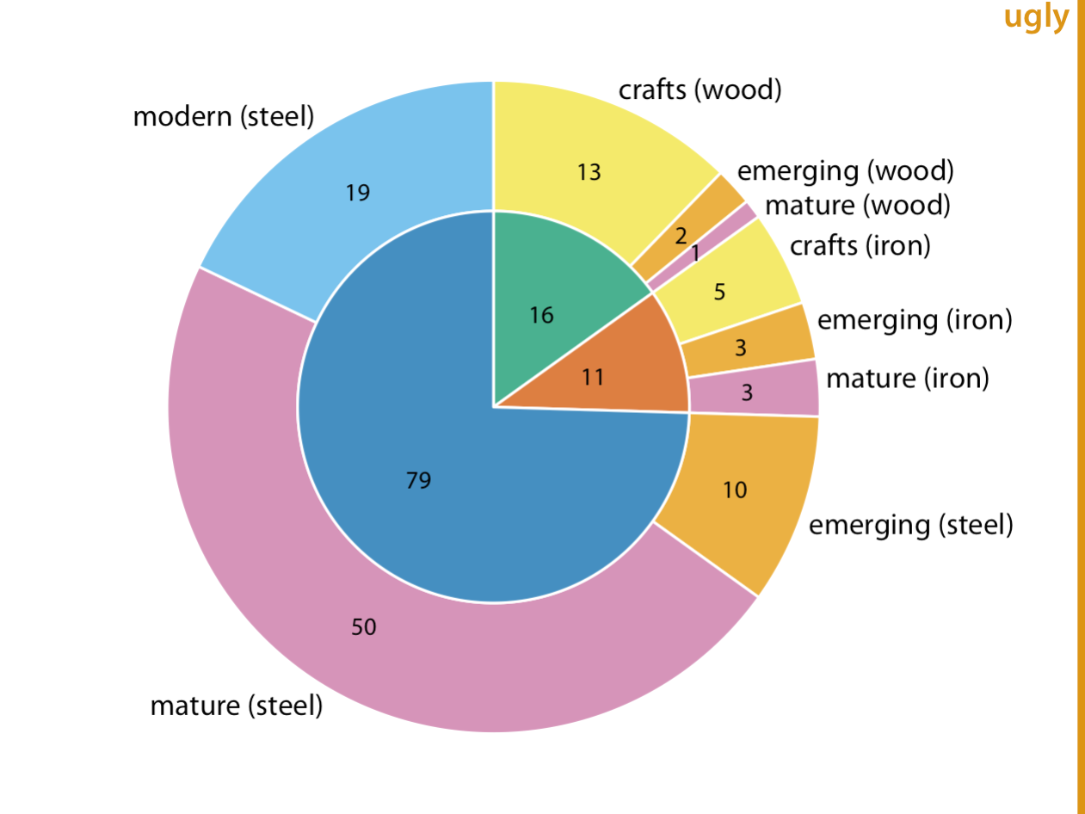
Nested Pies

Slide 6
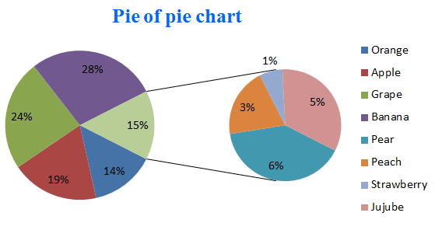
Pi of Pi chart

Slide 7
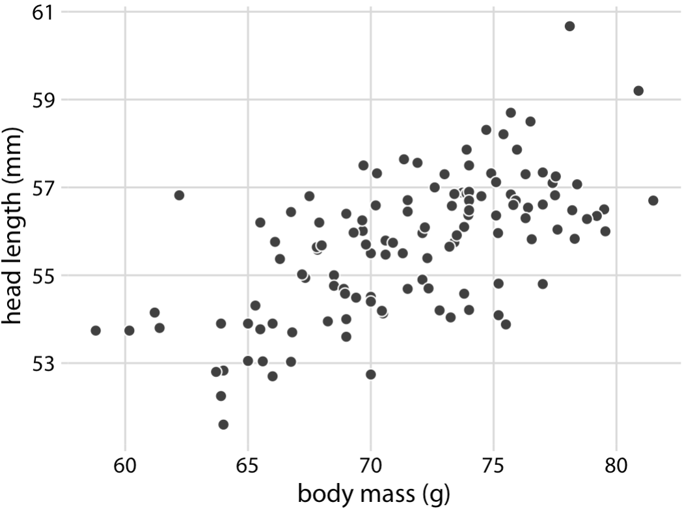
Visualizing Associations Among Two or More Quantitative Variables

Slide 8
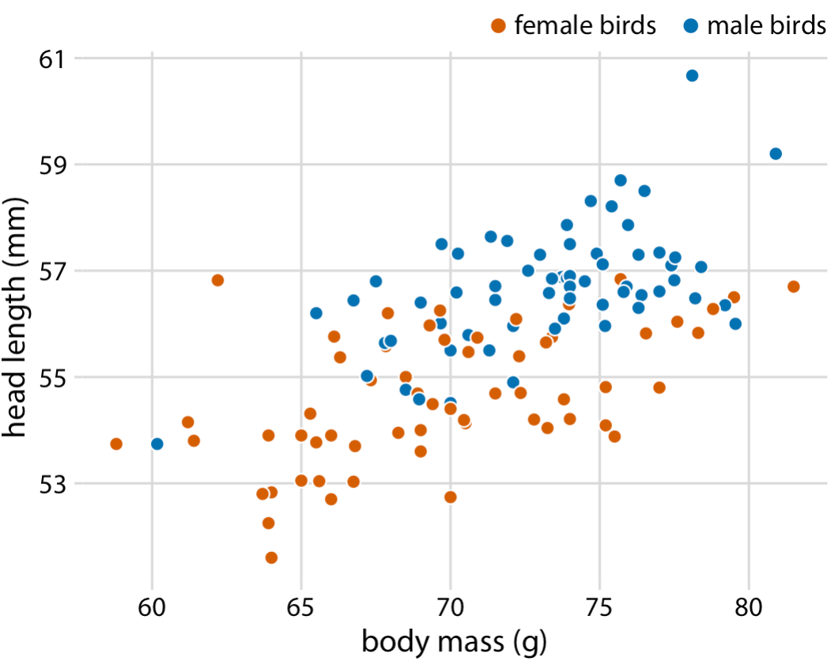
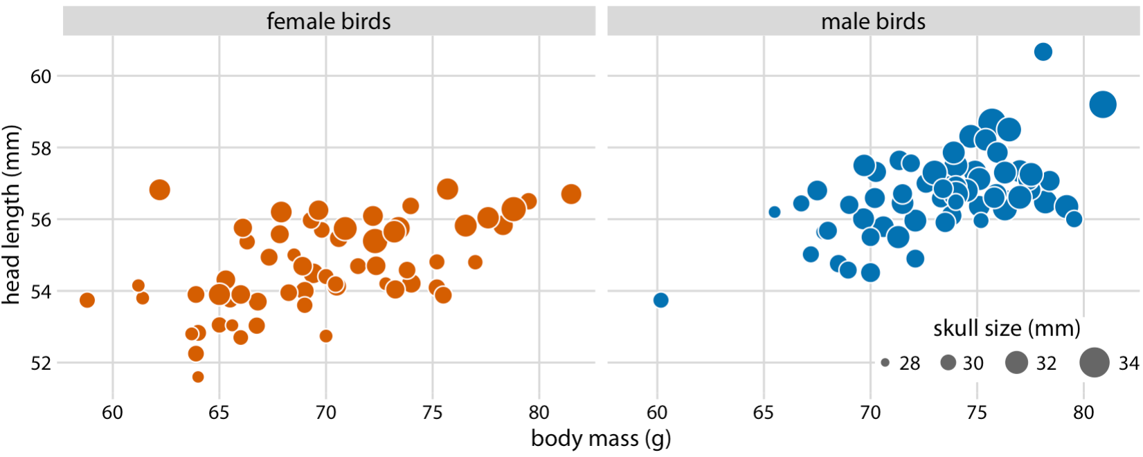
Visualizing Associations Among Two or More Quantitative Variables

Slide 9
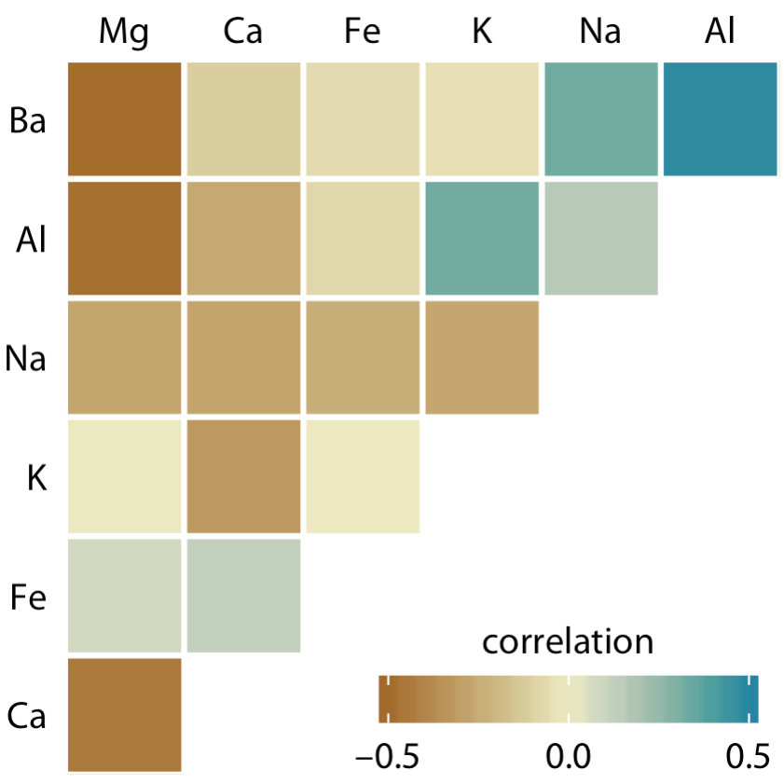
Correlograms

Slide 10
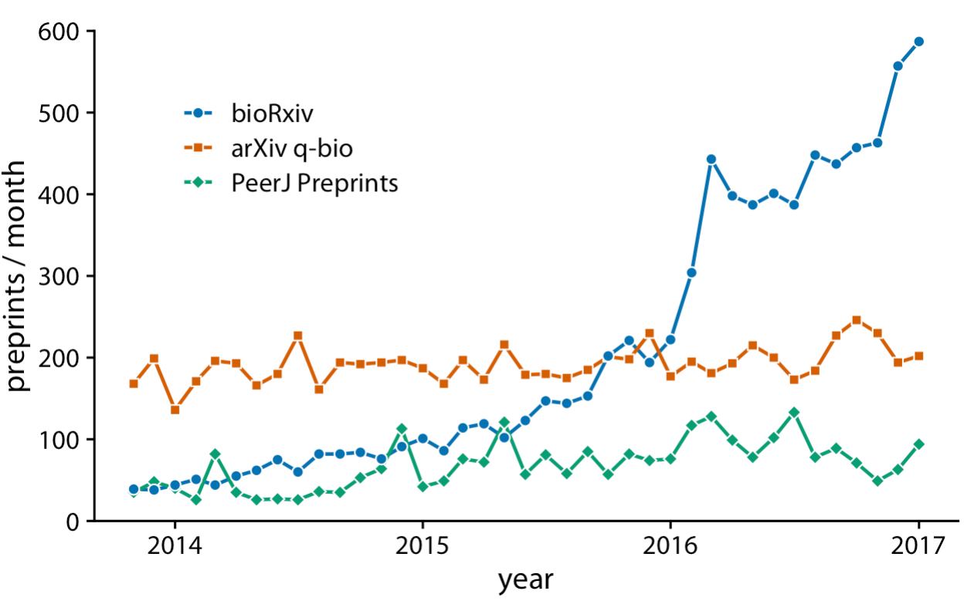
Visualizing Time Series and Other Functions of an Independent Variable
Multiple
Time Series Curve

Slide 11
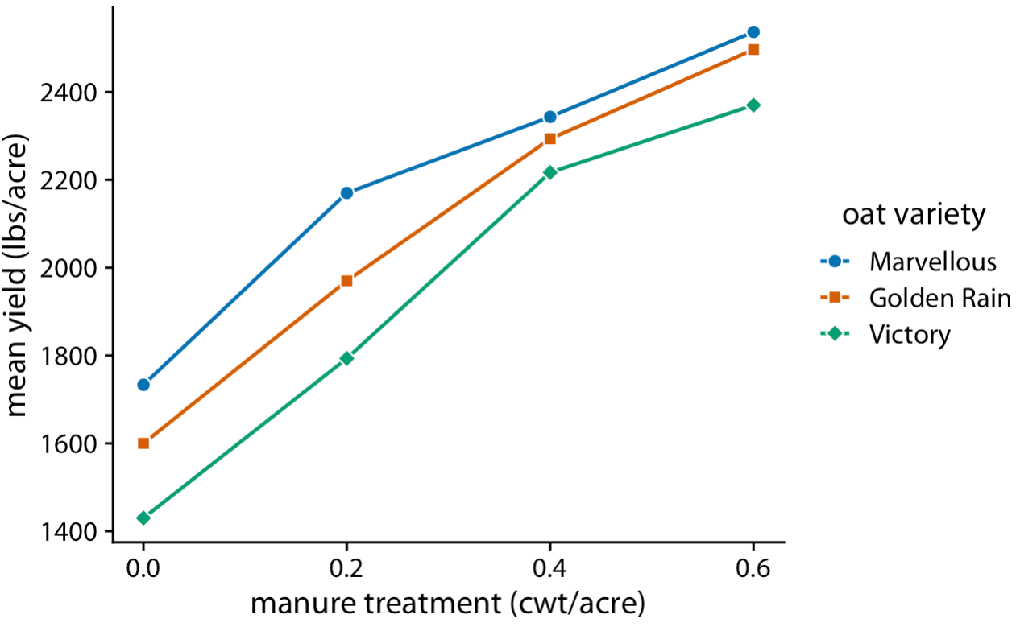
Dose Response Curve

Slide 12
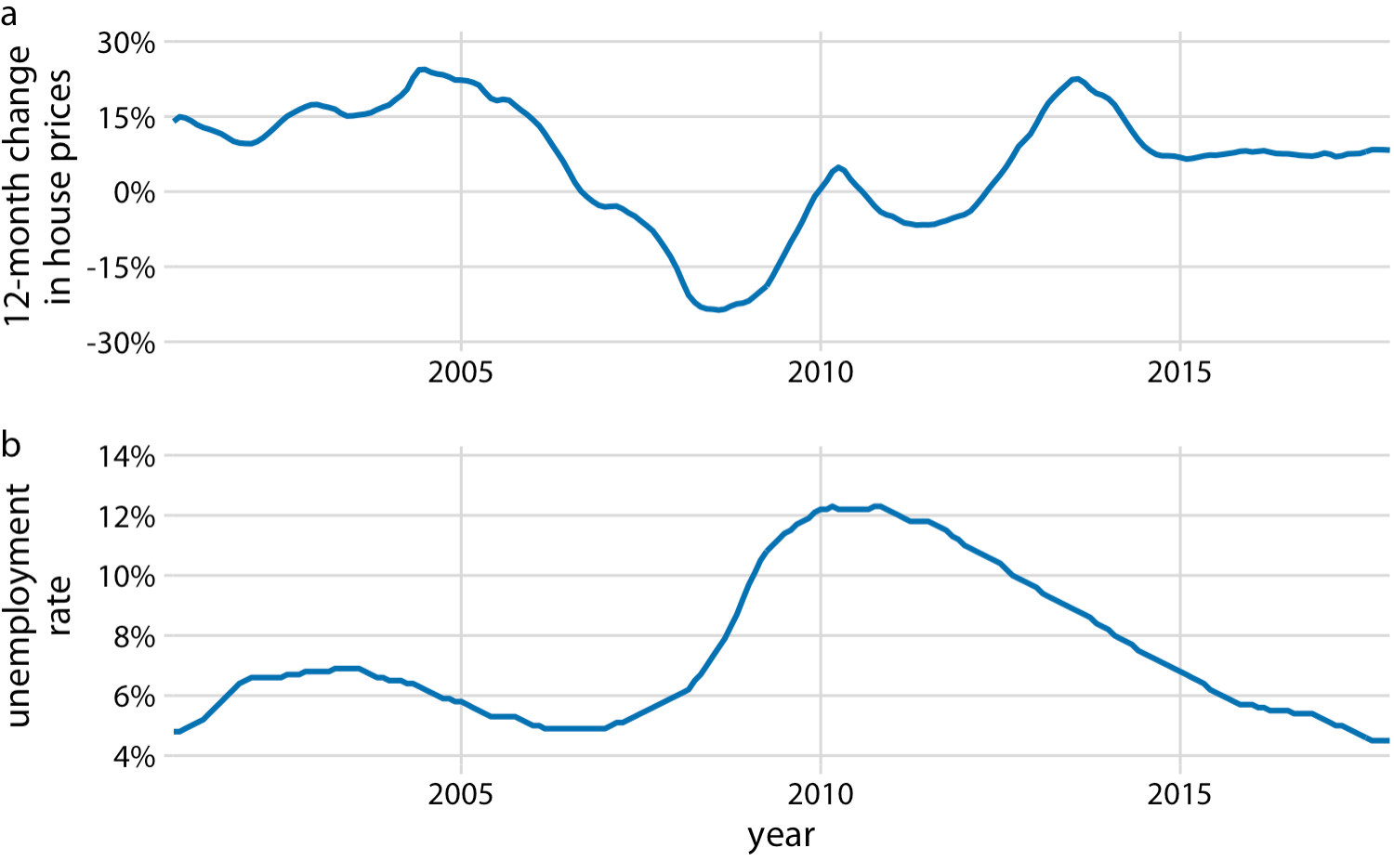
Time series with two or more than two response curve

Slide 13
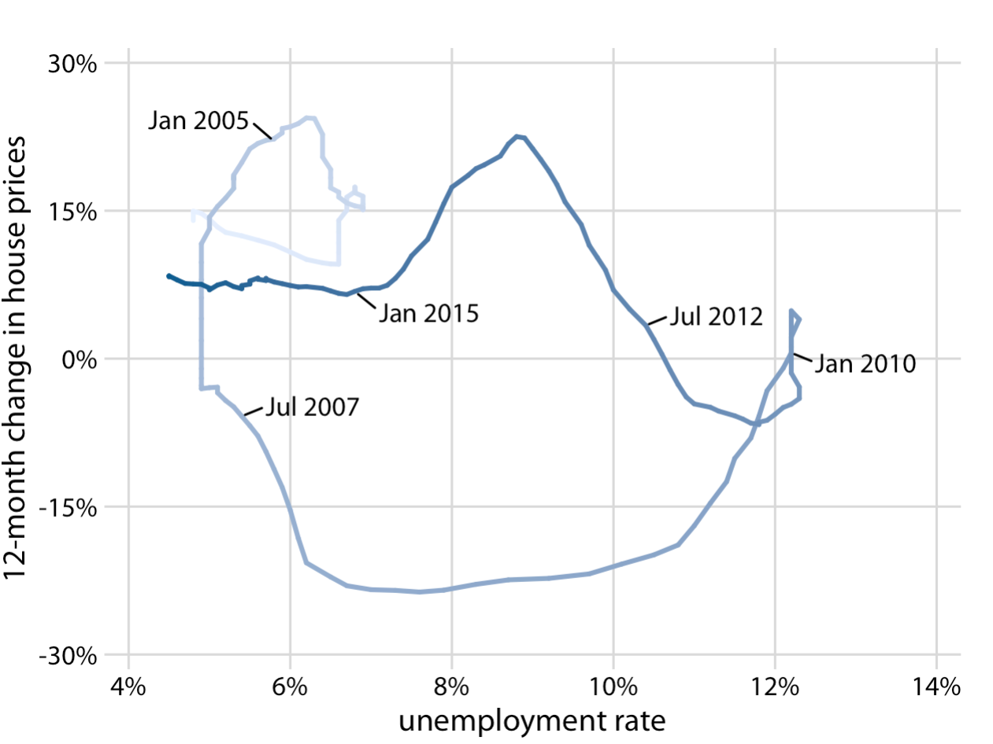
Time series with two or more than two response curve

Slide 14
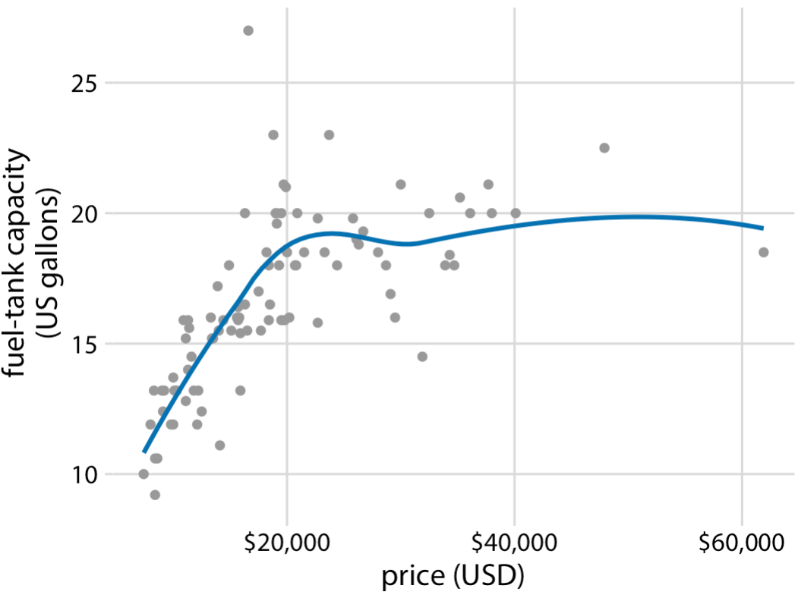
Visualizing Trends

Slide 15
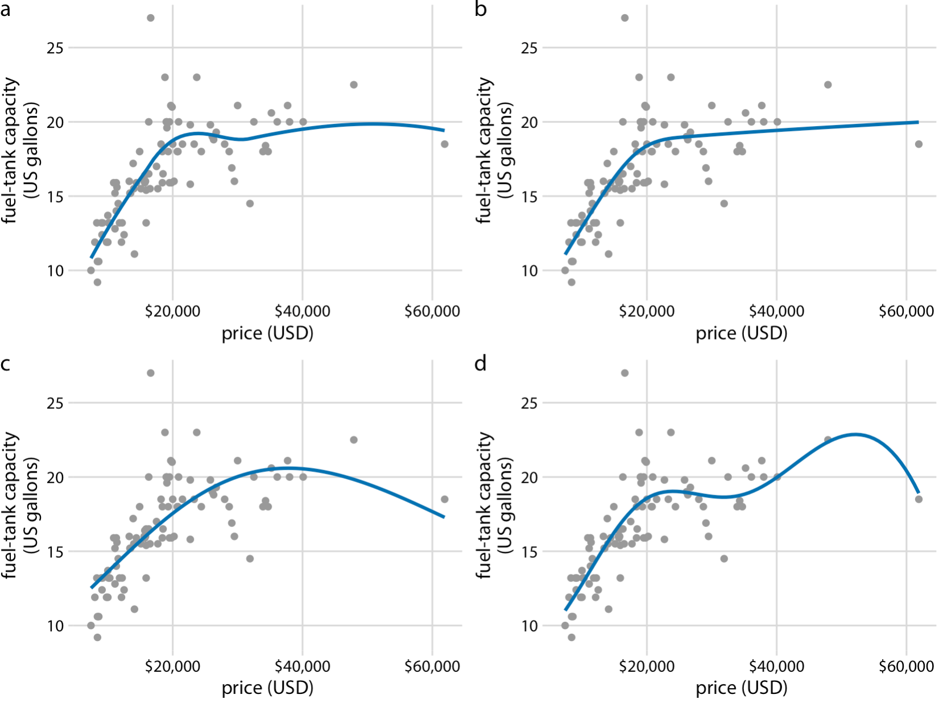
Visualizing Trends

Slide 16
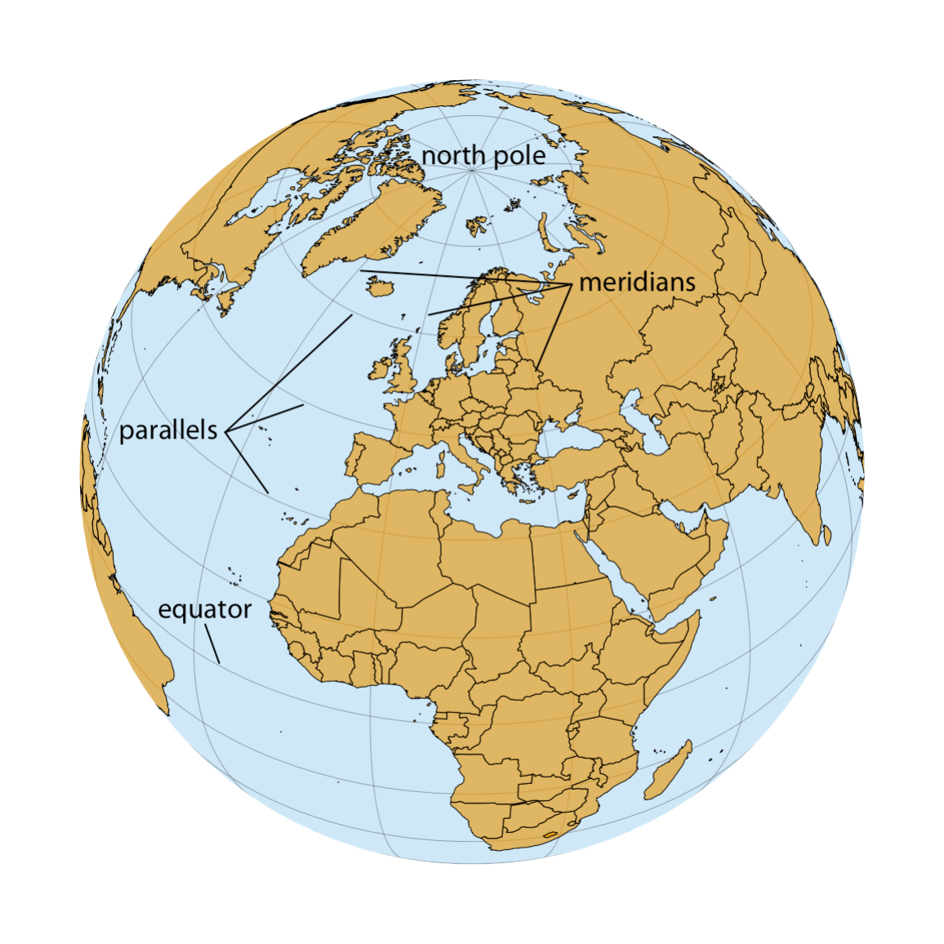
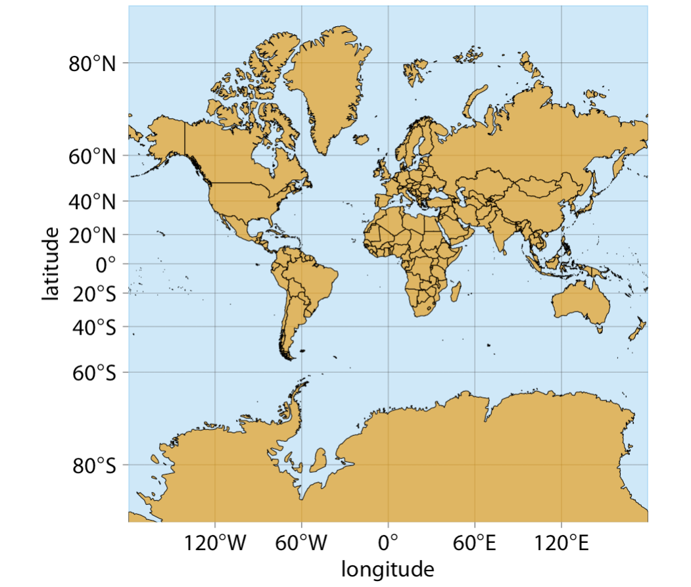
Visualizing Geospatial Data

Slide 17
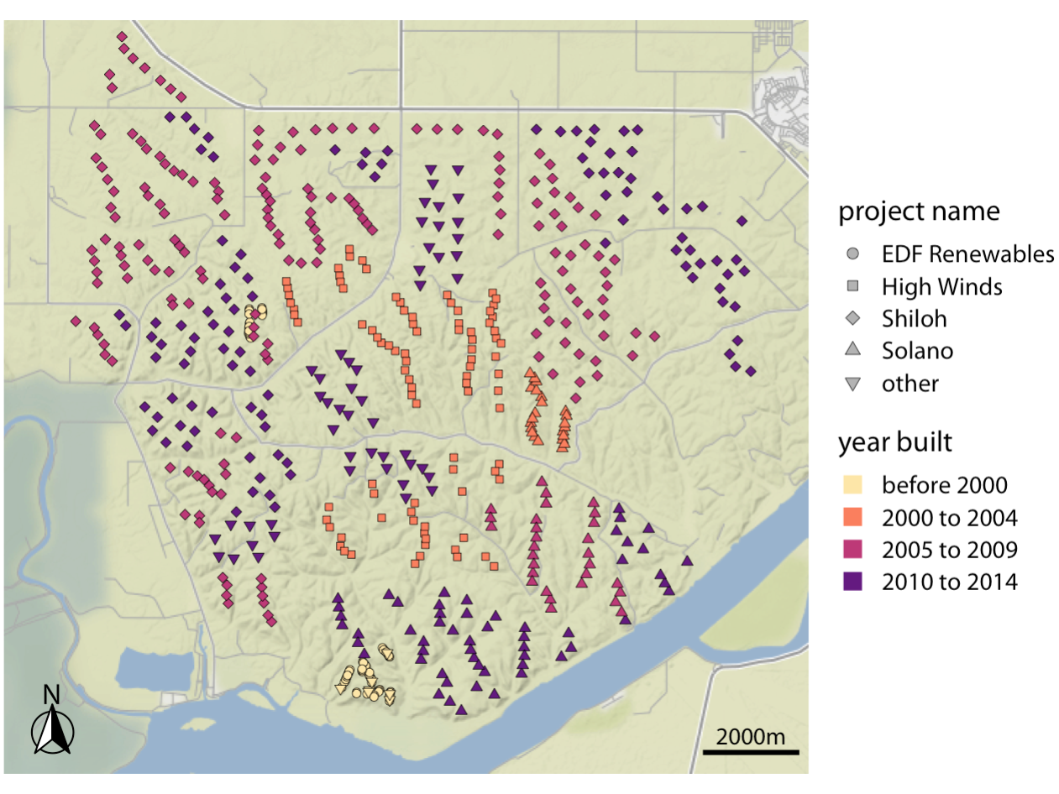
Data labelling with Geo-Spatial

